Slide 1
Members AGM & Liaison Meeting
KMC
February 22nd 2025

Slide 2
Agenda
KMC AGM & Liaison Meeting 22-2-25
Attendance Register
Welcome from the Chair & key messages
  KMC Performance, KMC Strategy - horizon planning (update for noting)
Horizon Planning (DW)
Board Succession and roles (APL)
  Retirements from The KMC Board (notifications)
  New Director appointments to the Board. Introduction to new members (update for noting)
  Succession planning
  Key messages from new Chairman
Financial Update (DW)
  2024 Accounts presented for review/approval (ratification approval required)
  General Financial Update (cash reserves, rental collections, budget 24-25, rental increases 24-5) Minimum Reserve fund amounts.
Success 2024
Community Fund (Craig Thompson / David Wright)
  Financial Summary for 2024-25
Member Open discussion (All)
  Open discussions

Slide 3
KMC Strategic Horizon Planning

Slide 4
KMC Horizon Planning and Strategic Review
Current Reality of KMC
Item |  | Comment
No units at KMC | 39 | Full breakdown on website.
No of Unit’s membership >15 | 24 | Less now given figures taken at last year end.
No Lodges | 20 | Down by 2.
No Royal Arch Chapters | 5
No Other units | 13
Dining |  | Majority of Festive Boards are now chosen from Sharer Menu.

Slide 5
KMC Horizon Planning
Some Key observations
The new Board will shortly issue a circulation asking for all Summons to be sent to the Board which will then be circulated to all appropriate Orders to try and encourage cross Visiting. This may boost dining numbers.
Strong use at KMC of units using National Social Media introductions via PGL team.
Proactive use at KMC of “X” to post items to wider Social Media followers.
The Board is still newly appointed and are still going through a steep learning curve. The Board are still very keen to receive feedback and suggestions. The “Third Rising” circulation is an effort to improve communication and open discussion between the Board and stakeholders.
Succession planning. New Board are very strong and committed. However, we need to be conscious of future changes to maintain continuity.

Slide 6
KMC Board
Succession, Retirement and New Members

Slide 7
Board Movements
Position | Was | To be | Note
Chair | KWR (stand down) | DW
Company Secretary | KWR | David Perkins (new)
Finance I | J K Starley | David Wright | Budgets/Fin Oversight Insurance
Finance II (Operational) | - | John Grinstead | Includes Operational finance and Bar Control
Catering | APL (stand down) | Craig Thompson
Comms & Website | DW | D Wright/Mrs RA Wright (new)
Bookings/IT Coy Sec | MP (stand down) | Ian McLeod (new)
Buildings | NC | Jon Bell (new)
Risk, Compliance and training | APL | Richard Pinn (new) | Fire, Defib, Compliance, H&S, etc
Tech and IT | MP | Outsourced | TechWizard

Slide 8
New Board member – Ian McLeod
Professional and Masonic Background
Happy to be Retired
32 years in Local Government finance and Business Change
8 years in private sector software implementation for Local Government
15 years as a Freemason
Member of Warwickshire Let's Talk Team
Coordinator for Easter Smiles (Provincial Easter Bunny)
Role undertaking for KMC Board
Company Digital Secretary
  Bookings
  Distribution
Companies House records.

Slide 9
Non-Executive Board member
Rosemary Wright
Professional and Masonic Background
Retired
18 years at Lloyds Bank Solihull and 17 years at Argos Solihull and Sears Retail Park as Team Leader, Recruitment and Charity
Dad, George Hayward PPSGW of Faith and Hope 4772 and my Brother John who is PPAGM.
Role undertaking for KMC Board
Webmaster.
Social media co-ordinator. Use of WIX and Twitter “ X”.
Chairman support.

Slide 10
Financial Update

Slide 11
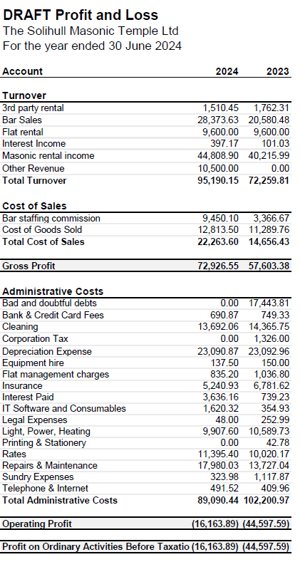

Slide 12
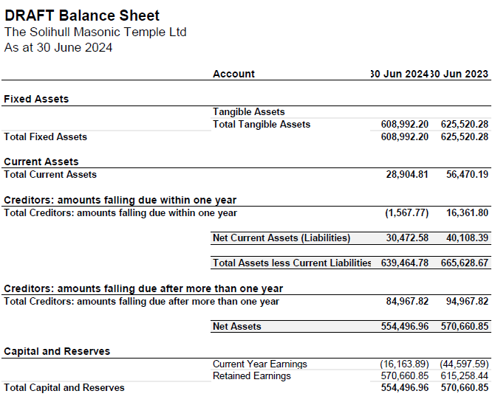

Slide 13
Rentals 2025/26
In previous year’s this has been set at CPI/RPI.
Last year increase was 5%.
Without entering into politics, CPI/RPI seems highly volatile and National Office of Statistics says 3.9% (managed?).
Rental Increase for 2025/26 will be 4%.
Which means £247.72 per meeting and £3.47 per capita.
The Board work continuously to improve and maintain financial viability of the business.

Slide 14
Successes 2024

Slide 15
Integration and acclimatisation of new Directors.
Issues with previous Suppliers who let the rooms down now resolved.
  Previous parties left a Judgement against the rooms
  Did not complete jobs i.e Kitchen floor – poor standard
  Simple maintenance not actioned or contact received.
New Facilities Management Company appointed.
  Thank you to Bro Dan Toth (8001) of Facility Solutions who are providing a better service for KMC.

Slide 16
KMC Community Fund
2024

Slide 17
Causes and donations in 2024/25
  December 2024 - Purchase of Food & goods for Solihull Renewal Centre food bank.
  December 2024 – Purchase of Toys for Solihull Renewal Centre.
  Requested “matching” from Provincial Grand Lodge.
  Provincial Easter Smiles Campaign
  As our Board Member is Ian McLeod, who is now the Co-Ordinator of the Provincial Easter Smiles scheme, the Board would like to add it’s support to the scheme on behalf of the members of Knowle Masonic Centre.
  Last year we donated to the Foodbank. we would like to repeat this in 2025.

Slide 18
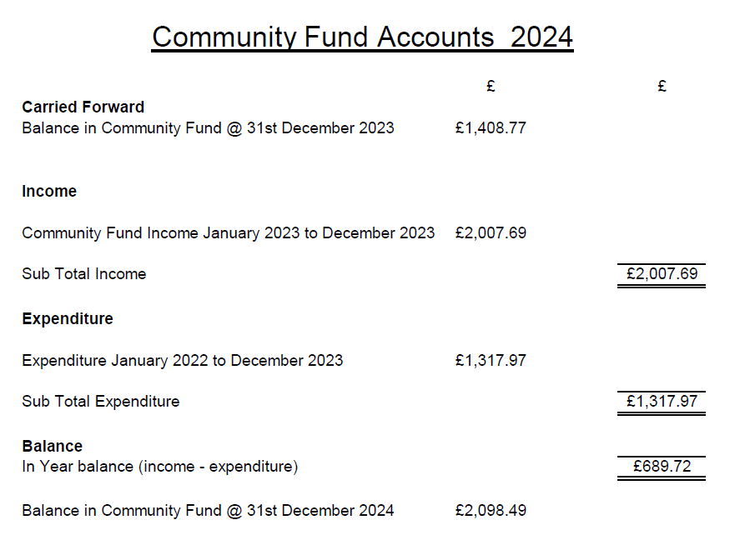

Slide 19
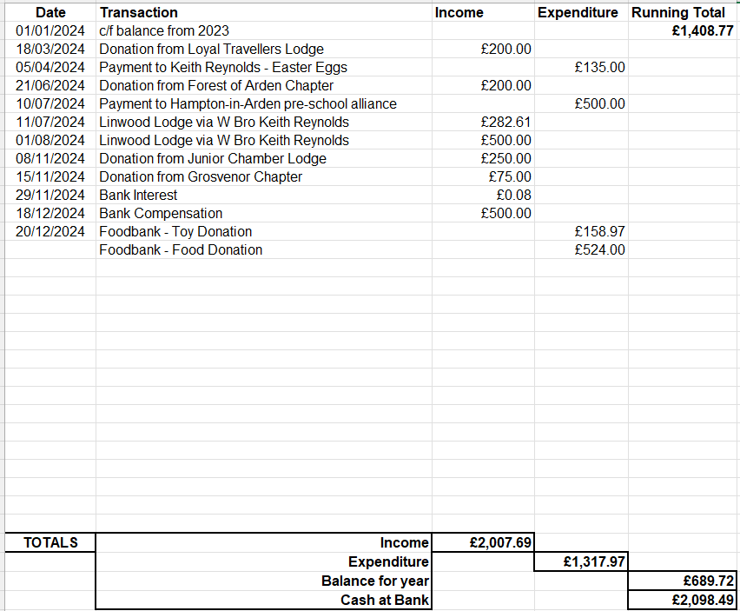

Slide 20
Members
Open Floor Discussion

Slide 21
Friends of the Temple

